Slide 1
Marketplace App
UML, Use & Test Cases
Team 7
Notes:
just a recap - we’re doing a marketplace based e-commerce web app, with customers being able to browse products and buy them, and sellers being able to list items for sale

Slide 2
UML Sequence Diagram
Payment processor
User
Online store
Inventory DB
Customer db
Adds item to cart
Item info query
Add item to customer cart
Order total
Display info and total
checkout
Confirm inv. availability
CC form
CC Processing
Order confirmation
Alt. A
Alt. B
Payment declined
Notes:
-going into uml diagram - we are representing a customer selecting an item to add to their cart, and then checking out
-the user initially clicks an add to cart button while on a product’s individual page, which let’s the online store know to query that item’s info,
-that info - will probably just be the primary key, product name, and price - is then inserted into the customer’s “cart”, which is stored in the customer database, along with the keys of other items that user has chosen
-the cart total and corresponding data is then displayed back to the customer.
-when the customer decides to checkout, by pressing a checkout button,
-our app first reconfirms inventory availability, as some things do sell in between the time it’s added to a cart and checkout.
-after inventory availability is confirmed, the user will be directed to a credit card input form
-that input will be sent to our payment processor, and depending on if the input is valid or not the user will be sent an “order confirmed” message or “payment declined” message

Slide 3

Use Case 1
Authenticate
<<includes>>
Login
Orders DB
Check Orders
Add Items
Seller
Inventory DB
Notes:
for our first use case we’re displaying how the seller will be using the application
-firstly we have the seller logging in - which will include an authentication use case
-after they’ve logged in they’ll be able to check if they have any new orders, which will be pulling from the Orders database
-they’ll also be add to add items to the inventory, which will be reading from the Inventory DB

Slide 4
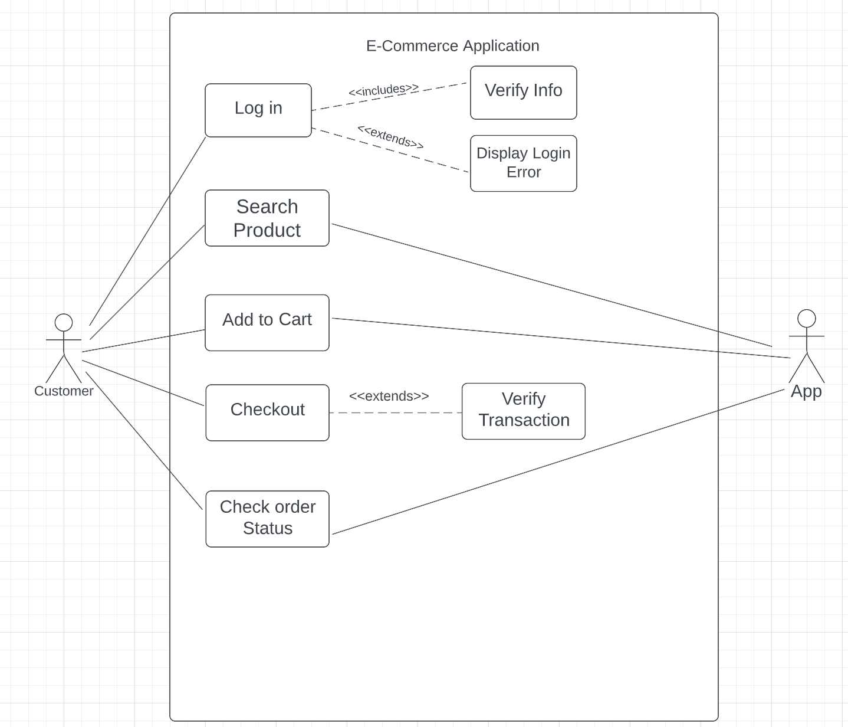
Use Case 2

Slide 5
Test Case 1
Test Scenario Test Case
System can create username
Check Login Functionality
Check Login Functionality
System can create password
System can validate username and password

Slide 6
Test Case 2
Test Scenario Test Case
Check user can access the Checkout page only after adding product to the cart
Checkout Functionality
Check Login Functionality
Check the mandatory fields of checkout page like Buyer Name, Address, City, State, ZIP are filled up.
Check the mandatory fields of payment page for example; Name on Card, Card Number, Expiration date and CVV are filled up.

